Slide 1


Deep Reinforcement Learning
Presented by Jonathan Zamora, Stone Tao, and Arth Shukla

Slide 2
ai-sp-ws3

Slide 3
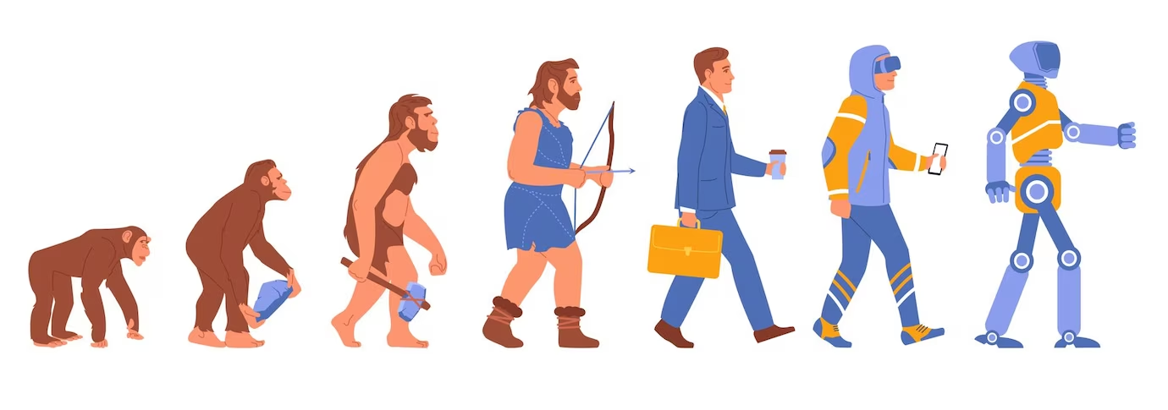
The Path Towards Intelligence

Slide 4

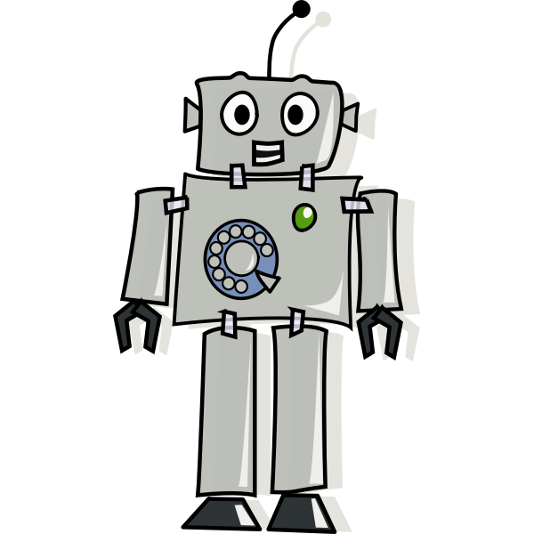
Teacher
Robot

Slide 5

Teacher
Robot
Data

Slide 6
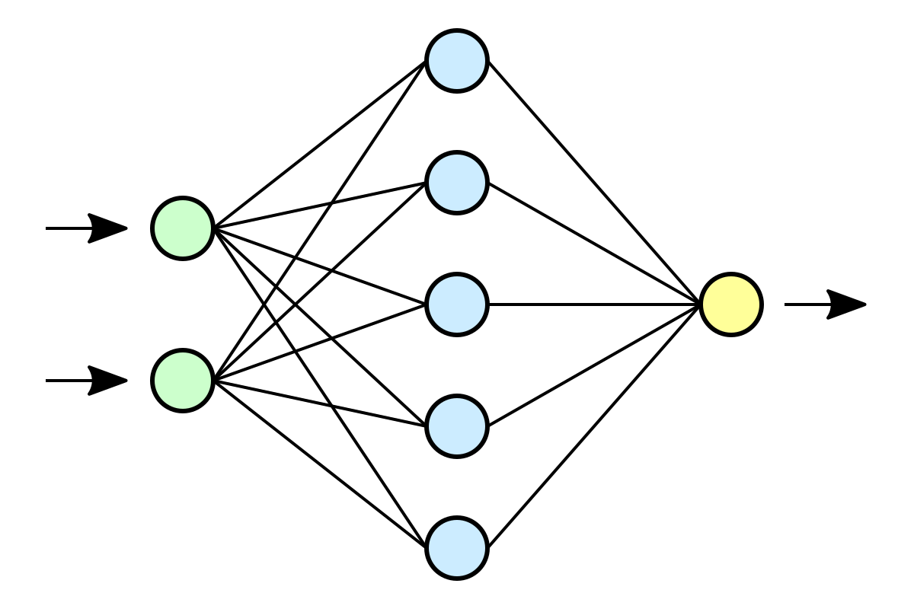
Teacher
Model
Data

Slide 7
Teacher
Model
Data

Slide 8
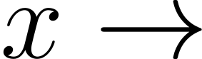
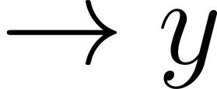
What is a Model?
Model

Slide 9
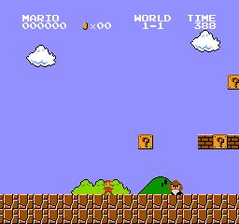
What is a Model?
Model
image

Slide 10
What is a Model?
Model
image
Question: What game am I playing?

Slide 11
What is a Model?
Model
Prediction: Super Mario Bros
image
Question: What game am I playing?

Slide 12
Can we utilize models for making decisions?
Model

Slide 13
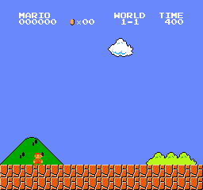
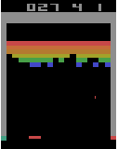
Games

Slide 14
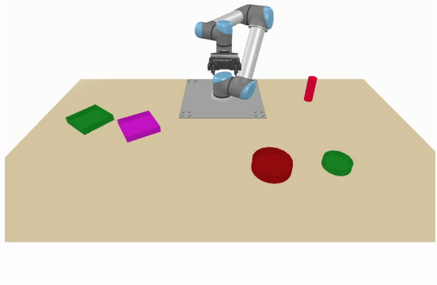
Games
Robotics

Slide 15
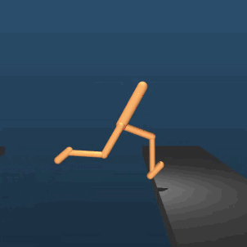

Games
Robotics
Control Problems

Slide 16
The Key: Deep Reinforcement Learning
Games
Robotics
Control Problems

Slide 17
The Key: Deep Reinforcement Learning
An Agent (an AI) will learn from its environment by:
interacting with it (through trial and error)
receiving Rewards (negative (-) or positive (+)) after performing actions

Slide 18
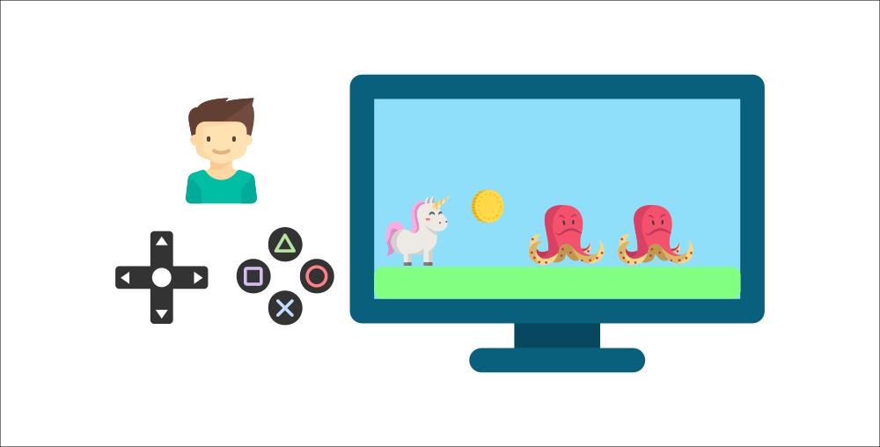
For Instance:

Slide 19
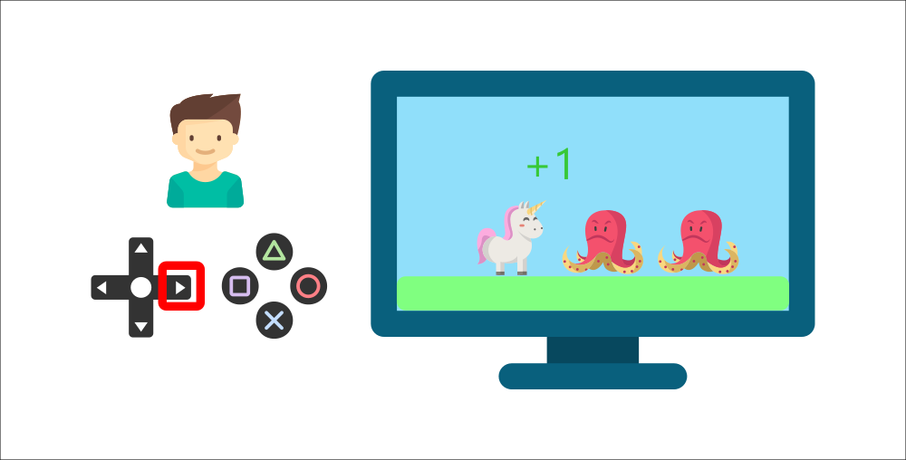
For Instance:

Slide 20
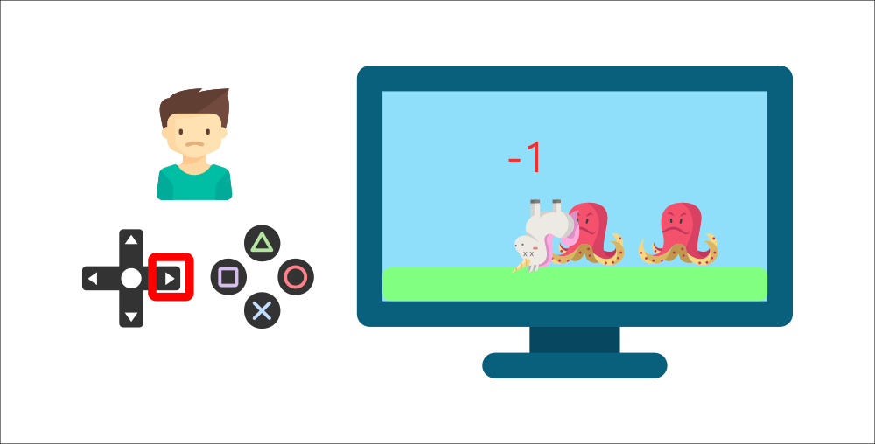
For Instance:

Slide 21
For Instance:
Without supervision, the child
will get better at the game

Slide 22
For Instance:
Without supervision, the child
will get better at the game
This is how humans and animals learn – through interaction

Slide 23
For Instance:
Without supervision, the child
will get better at the game
This is how humans and animals learn – through interaction
Reinforcement Learning is just a computational approach for learning from actions

Slide 24
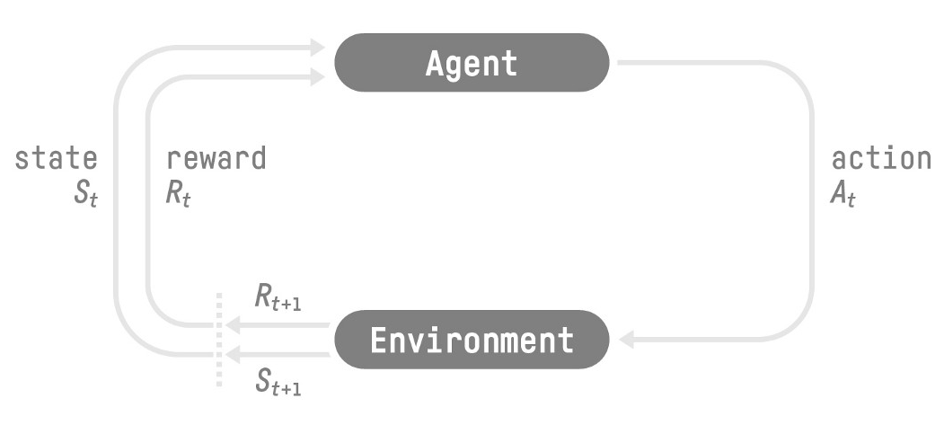
The RL Process

Slide 25
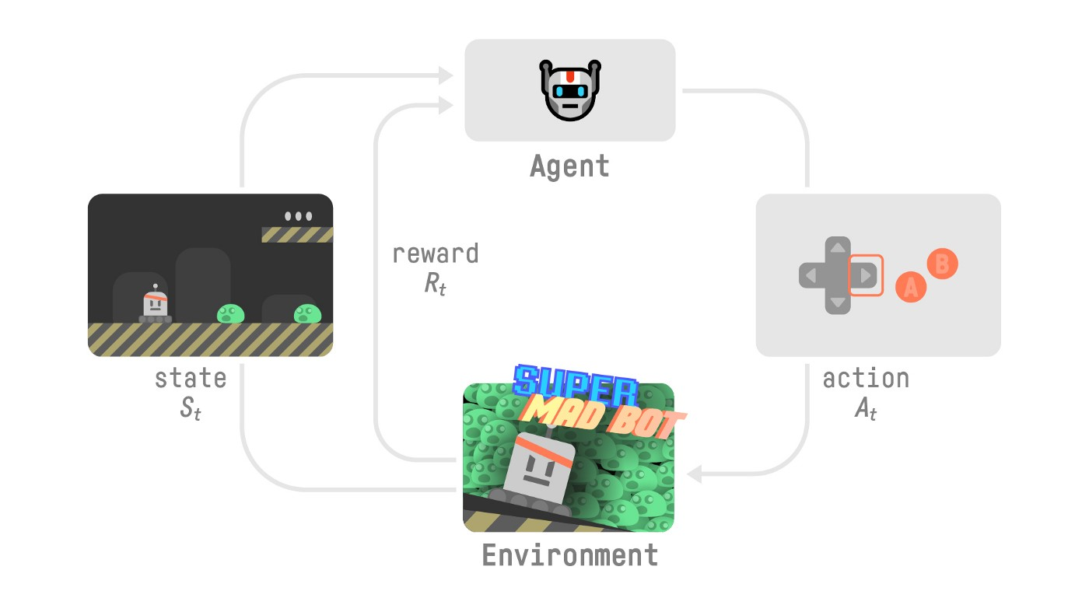
The RL Process: Platformer Game Example

Slide 26
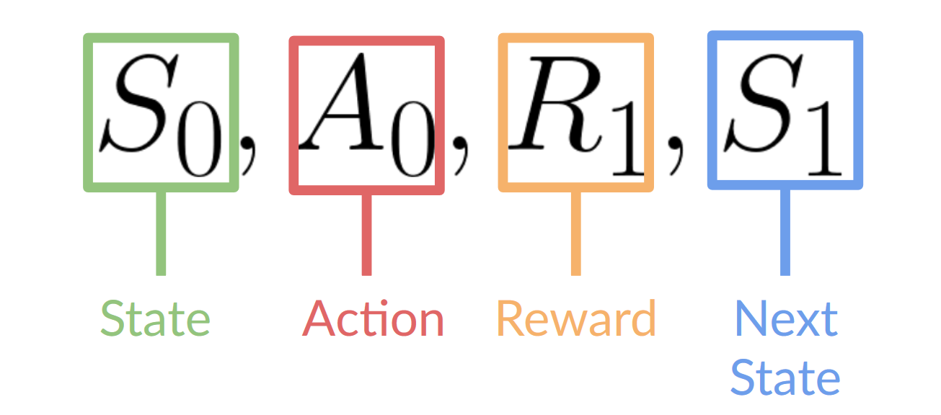
The RL Process: Platformer Game Example

Slide 27
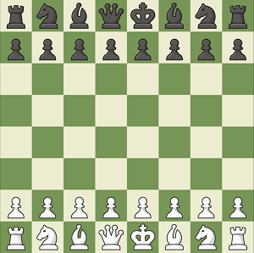
Observations/State Space
State S - A complete description of the state of the world. In a fully observed environment.

Slide 28
Observations/State Space
State S - A complete description of the state of the world. In a fully observed environment.
Observation O - A partial description of the state of the world. In a partially observed environment.

Slide 29
Action Space
Discrete Space: # of possible actions is finite

Slide 30
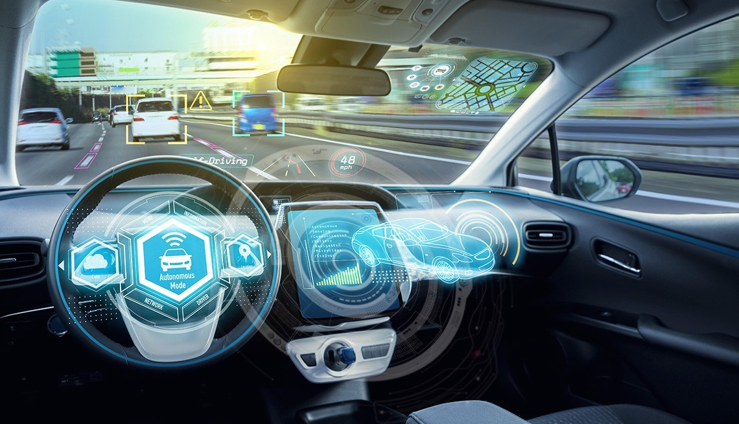
Action Space
Discrete Space: # of possible actions is finite
Continuous Space: # of possible actions is infinite

Slide 31
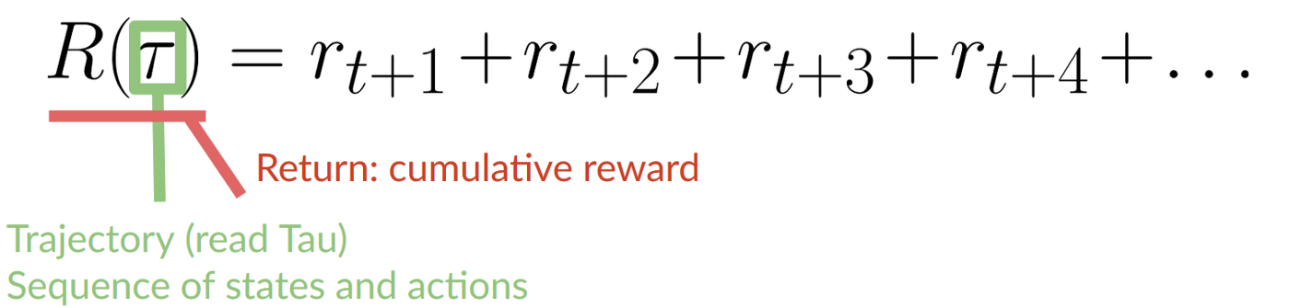
Rewards

Slide 32
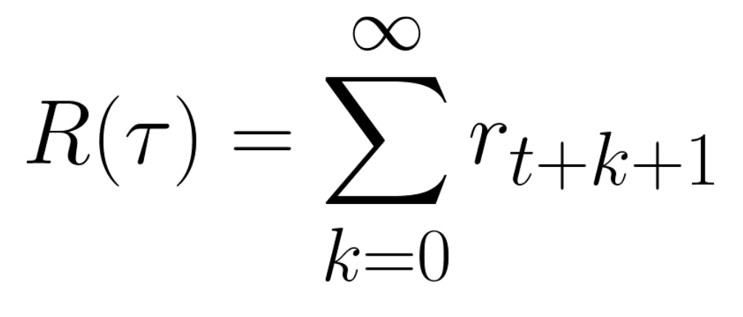
Rewards
Cumulative Reward

Slide 33
Rewards and Discounting
Cumulative Reward
1 Problem: We can’t just add the rewards like this.

Slide 34
Rewards and Discounting
Cumulative Reward
1 Problem: We can’t just add the rewards like this.
Rewards at start of game are more likely to happen since they are more predictable than future reward

Slide 35
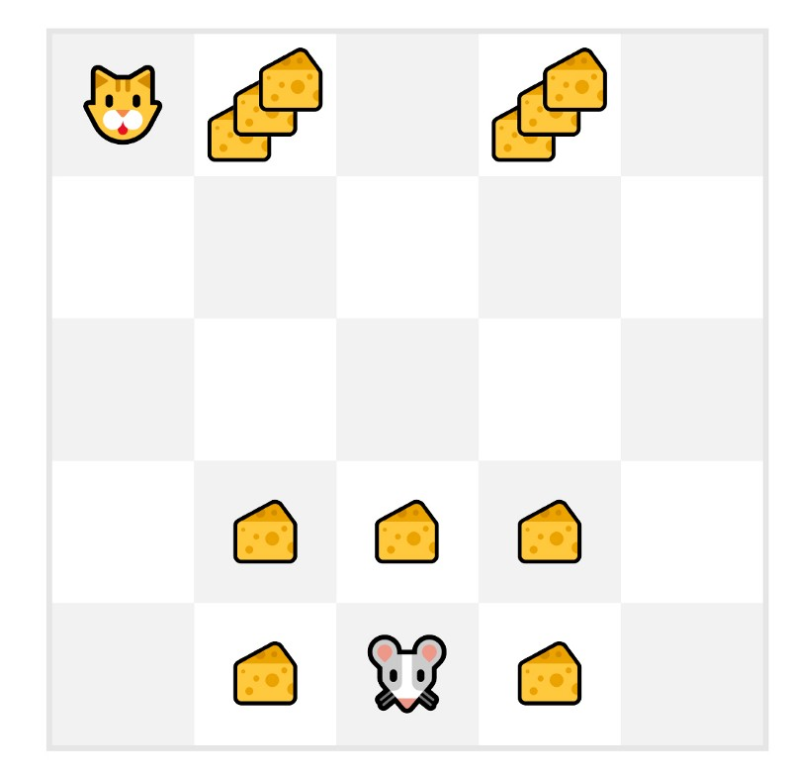
Rewards and Discounting
Cumulative Reward
1 Problem: We can’t just add the rewards like this.
Rewards at start of game are more likely to happen since they are more predictable than future reward

Slide 36
Rewards and Discounting
Cumulative Reward
We define a discount rate gamma
Must be between 0 and 1
1 Problem: We can’t just add the rewards like this.
Rewards at start of game are more likely to happen since they are more predictable than future reward

Slide 37
Rewards and Discounting
Cumulative Reward
We define a discount rate gamma
Must be between 0 and 1
Large Gamma, Smaller Discount - We care about long-term reward
1 Problem: We can’t just add the rewards like this.
Rewards at start of game are more likely to happen since they are more predictable than future reward

Slide 38
Rewards and Discounting
Cumulative Reward
We define a discount rate gamma
Must be between 0 and 1
Large Gamma, Smaller Discount - We care about long-term reward
Small Gamma, Larger Discount - We care about short-term reward
1 Problem: We can’t just add the rewards like this.
Rewards at start of game are more likely to happen since they are more predictable than future reward

Slide 39
Rewards and Discounting
Cumulative Reward
We define a discount rate gamma
Must be between 0 and 1
Large Gamma, Smaller Discount - We care about long-term reward
Small Gamma, Larger Discount - We care about short-term reward
Each reward is discounted by gamma to the exponent of the timestep
1 Problem: We can’t just add the rewards like this.
Rewards at start of game are more likely to happen since they are more predictable than future reward

Slide 40
Rewards and Discounting
Cumulative Reward
We define a discount rate gamma
Must be between 0 and 1
Large Gamma, Smaller Discount - We care about long-term reward
Small Gamma, Larger Discount - We care about short-term reward
Each reward is discounted by gamma to the exponent of the timestep
As timestep increases, the cat gets closer to us, so future reward is less likely to happen
1 Problem: We can’t just add the rewards like this.
Rewards at start of game are more likely to happen since they are more predictable than future reward

Slide 41
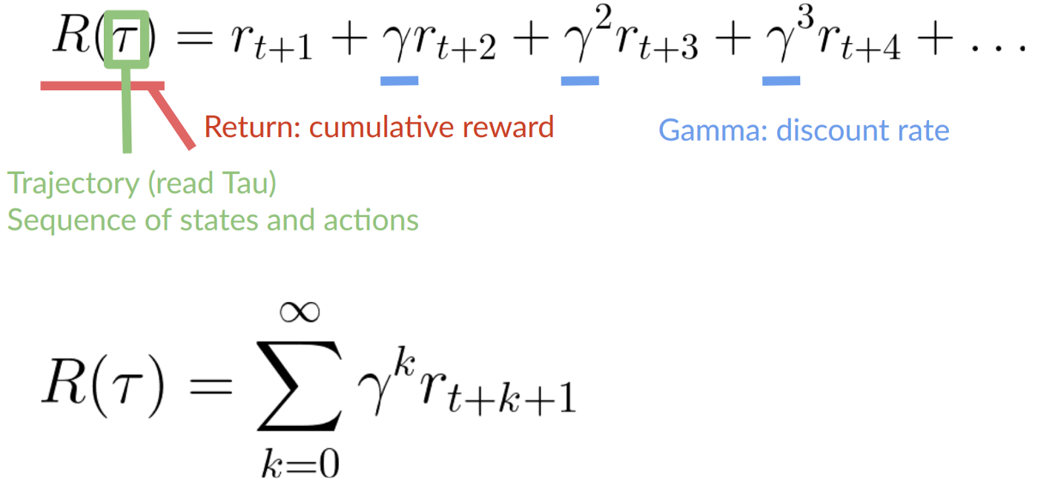
Rewards and Discounting
Discounted Cumulative Reward
We define a discount rate gamma
Must be between 0 and 1
Large Gamma, Smaller Discount - We care about long-term reward
Small Gamma, Larger Discount - We care about short-term reward
Each reward is discounted by gamma to the exponent of the timestep
As timestep increases, the cat gets closer to us, so future reward is less likely to happen

Slide 42
Types of Tasks
Episodic Task: We have a starting point and an ending point (terminal state)
This creates an Episode - a list of States, Actions, Rewards, and Next States

Slide 43
Types of Tasks
Episodic Task: We have a starting point and an ending point (terminal state)
This creates an Episode - a list of States, Actions, Rewards, and Next States
Continuing Task: We have no terminal state
The agent must learn (1) how to choose best actions and (2) how to best interact with the environment

Slide 44
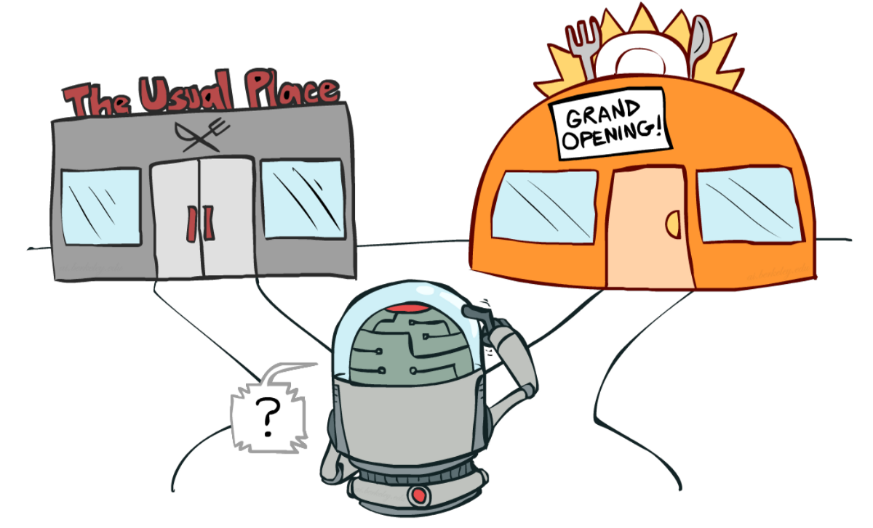
Exploration and Exploitation Tradeoff

Slide 45
Exploration and Exploitation Tradeoff
Exploitation – Exploit known information to maximize reward

Slide 46
Exploration and Exploitation Tradeoff
Exploitation – Exploit known information to maximize reward
Exploration – Explore environment by trying random actions to learn more about the env

Slide 47
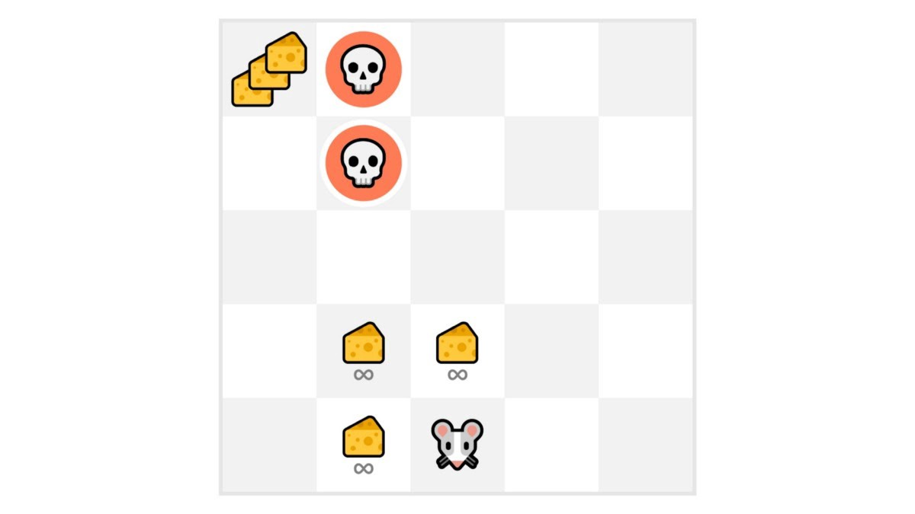
Exploration and Exploitation Tradeoff
Exploitation – Exploit known information to maximize reward
Our mouse can have an infinite amount of small cheese (+1)
Exploration – Explore environment by trying random actions to learn more about the env

Slide 48
Exploration and Exploitation Tradeoff
Exploitation – Exploit known information to maximize reward
Our mouse can have an infinite amount of small cheese (+1)
However, there is a gigantic sum of cheese (+1000) at the top of the maze
Exploration – Explore environment by trying random actions to learn more about the env

Slide 49
Exploration and Exploitation Tradeoff
This is the Exploration and Exploitation Tradeoff
Exploitation – Exploit known information to maximize reward
Our mouse can have an infinite amount of small cheese (+1)
However, there is a gigantic sum of cheese (+1000) at the top of the maze
Exploration – Explore environment by trying random actions to learn more about the env

Slide 50
Exploration and Exploitation Tradeoff
We must define a rule to help handle this tradeoff
We will go over this soon
Exploitation – Exploit known information to maximize reward
Our mouse can have an infinite amount of small cheese (+1)
However, there is a gigantic sum of cheese (+1000) at the top of the maze
Exploration – Explore environment by trying random actions to learn more about the env

Slide 51
2 Main Approaches for Solving Problems w/ RL
How do we build an RL agent that can select actions which maximize its expected cumulative reward?

Slide 52
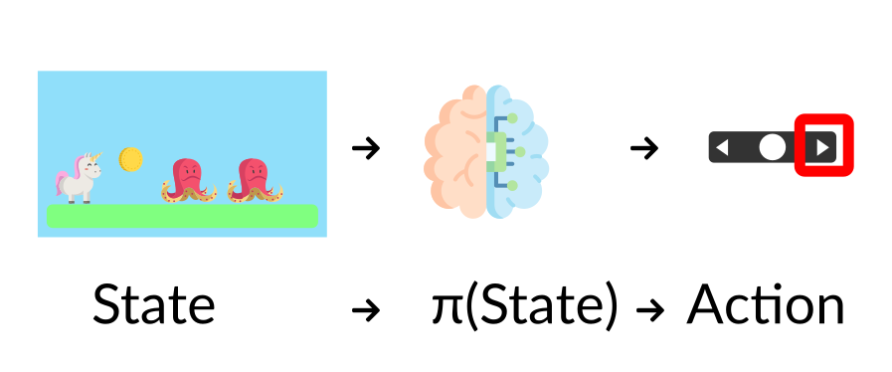
2 Main Approaches for Solving Problems w/ RL
How do we build an RL agent that can select actions which maximize its expected cumulative reward?
The Policy π: The Agent’s Brain
This is a function which tells us what action to take, given the state we are in
This is a function we want to learn, and our goal is find the optimal policy π*, the policy which maximizes expected return

Slide 53
2 Main Approaches for Solving Problems w/ RL
How do we build an RL agent that can select actions which maximize its expected cumulative reward?
There are 2 approaches for training our agent to find the optimal policy π*
The Policy π: The Agent’s Brain
This is a function which tells us what action to take, given the state we are in
This is a function we want to learn, and our goal is find the optimal policy π*, the policy which maximizes expected return

Slide 54
2 Main Approaches for Solving Problems w/ RL
How do we build an RL agent that can select actions which maximize its expected cumulative reward?
There are 2 approaches for training our agent to find the optimal policy π*
Directly, by teaching the agent to learn which action to take, given the current state – this is a Policy-Based Method
Indirectly, by teaching the agent to learn which state is more valuable, and then take the action that leads to this more valuable state – this is a Value-Based Method
The Policy π: The Agent’s Brain
This is a function which tells us what action to take, given the state we are in
This is a function we want to learn, and our goal is find the optimal policy π*, the policy which maximizes expected return

Slide 55
2 Main Approaches for Solving Problems w/ RL
How do we build an RL agent that can select actions which maximize its expected cumulative reward?
There are 2 approaches for training our agent to find the optimal policy π*
Directly, by teaching the agent to learn which action to take, given the current state – this is a Policy-Based Method
Indirectly, by teaching the agent to learn which state is more valuable, and then take the action that leads to this more valuable state – this is a Value-Based Method
The Policy π: The Agent’s Brain
This is a function which tells us what action to take, given the state we are in
This is a function we want to learn, and our goal is find the optimal policy π*, the policy which maximizes expected return

Slide 56
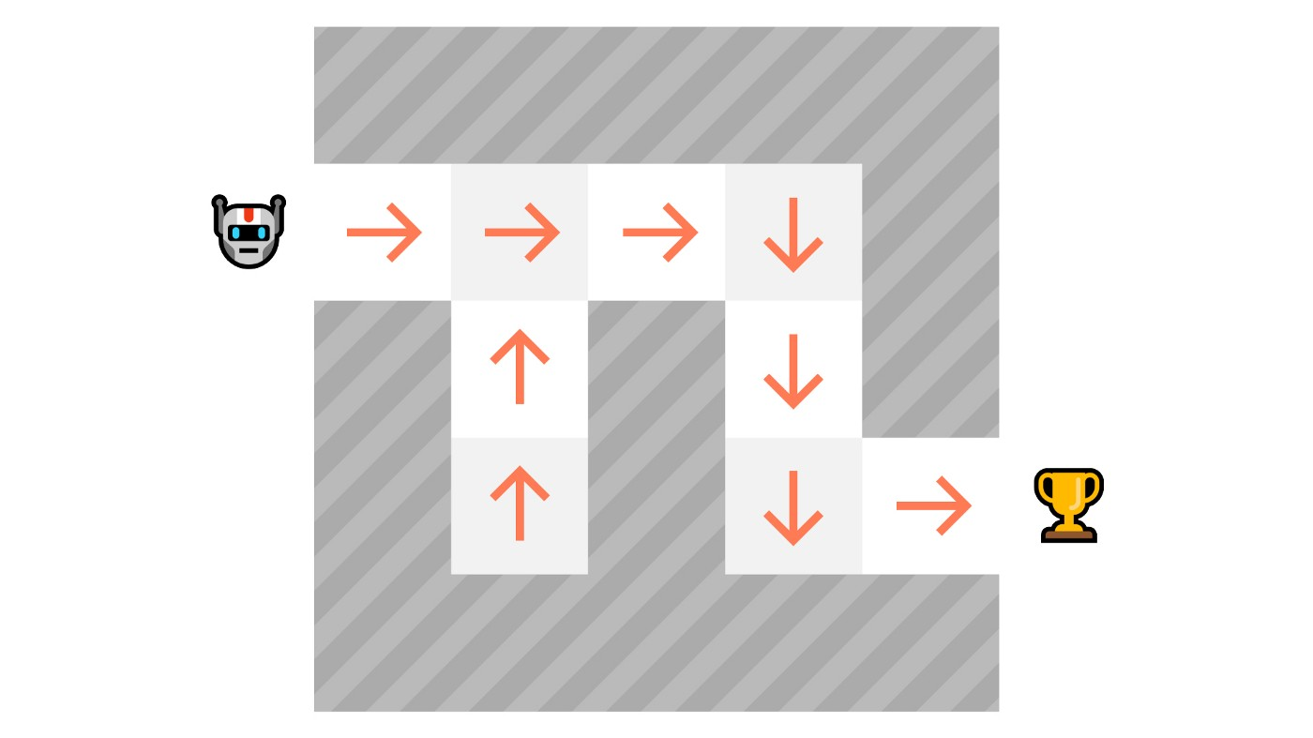
Policy-Based Methods
In Policy-Based Methods, we learn a policy function directly
This function will define a mapping from each state to the best corresponding action
Alternatively, it can also define a probability distribution over the set of possible actions at that state

Slide 57
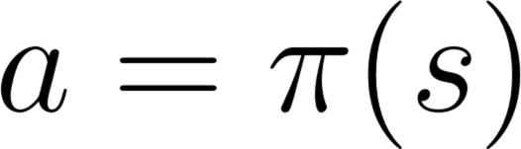
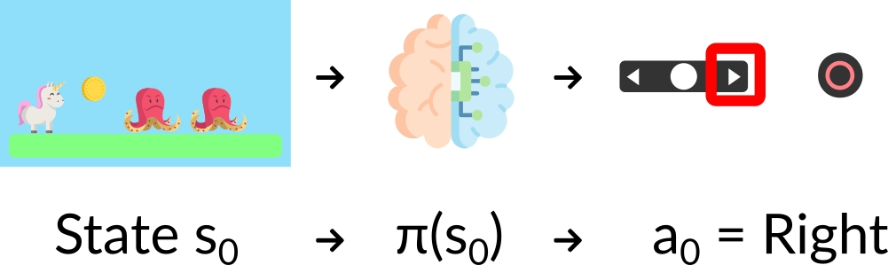
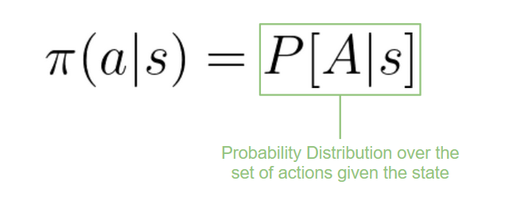
We have 2 Types of Policies
Deterministic: A Policy at a Given State will always return the same action
e.g. pi(s_0) -> a_0 = Right
Stochastic: A Policy at a Given State outputs a probability distribution over actions
Given an initial state, our stochastic policy will output the probability distributions over the possible actions at that state
e.g. pi(A|s_0) -> [Left: 0.1, Right: 0.7, Jump: 0.2]
action = policy(state)

Slide 58
We have 2 Types of Policies
Deterministic: A Policy at a Given State will always return the same action
e.g. pi(s_0) -> a_0 = Right
Stochastic: A Policy at a Given State outputs a probability distribution over actions
Given an initial state, our stochastic policy will output the probability distributions over the possible actions at that state
e.g. pi(A|s_0) -> [Left: 0.1, Right: 0.7, Jump: 0.2]
action = policy(state)

Slide 59
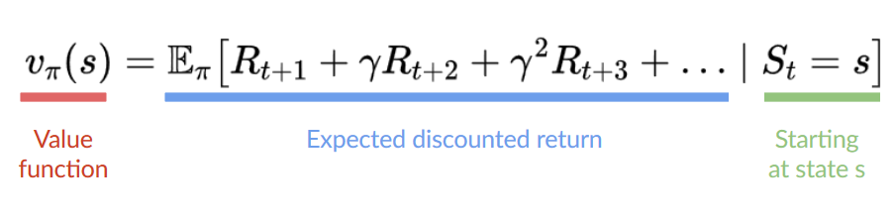
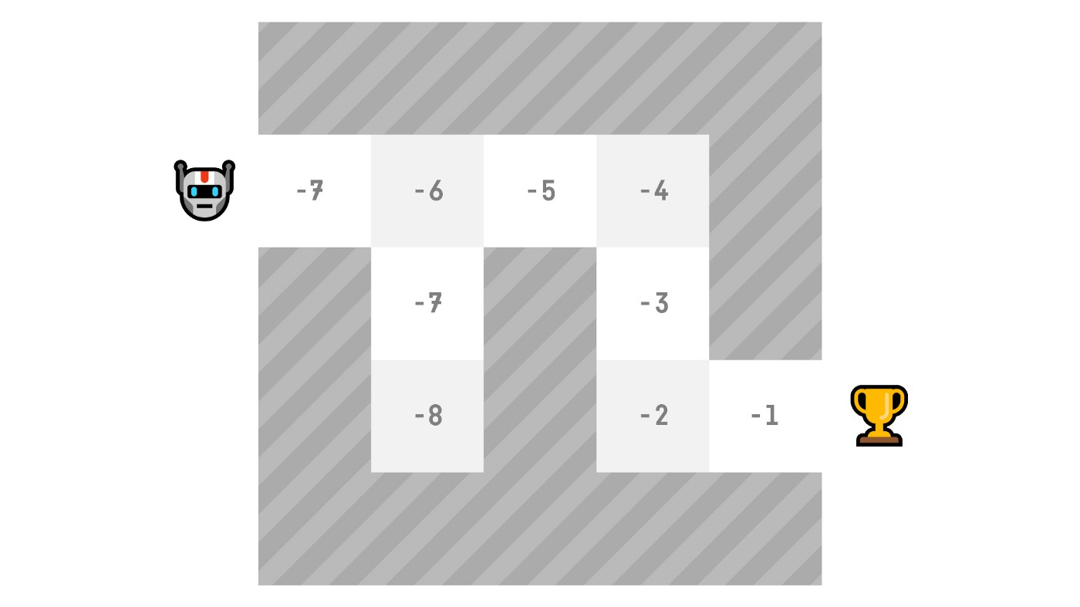
Value-Based Methods
In Value-Based Methods, instead of learning a policy function, we learn a value function indirectly
The value function maps a state to the expected value of being at that state
The value of a state is the expected discounted return the agent can get if it starts in that state, and then acts according to the policy
Our value function defines values for each possible state
Our policy will select the state w/ the largest value defined by the value function: [-7, -6, -5, -4, -3, -2, -1] to attain the goal

Slide 60
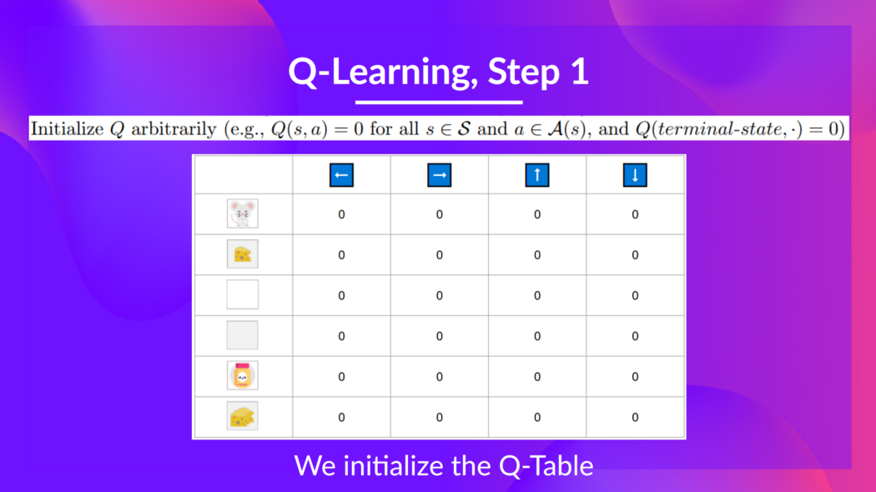
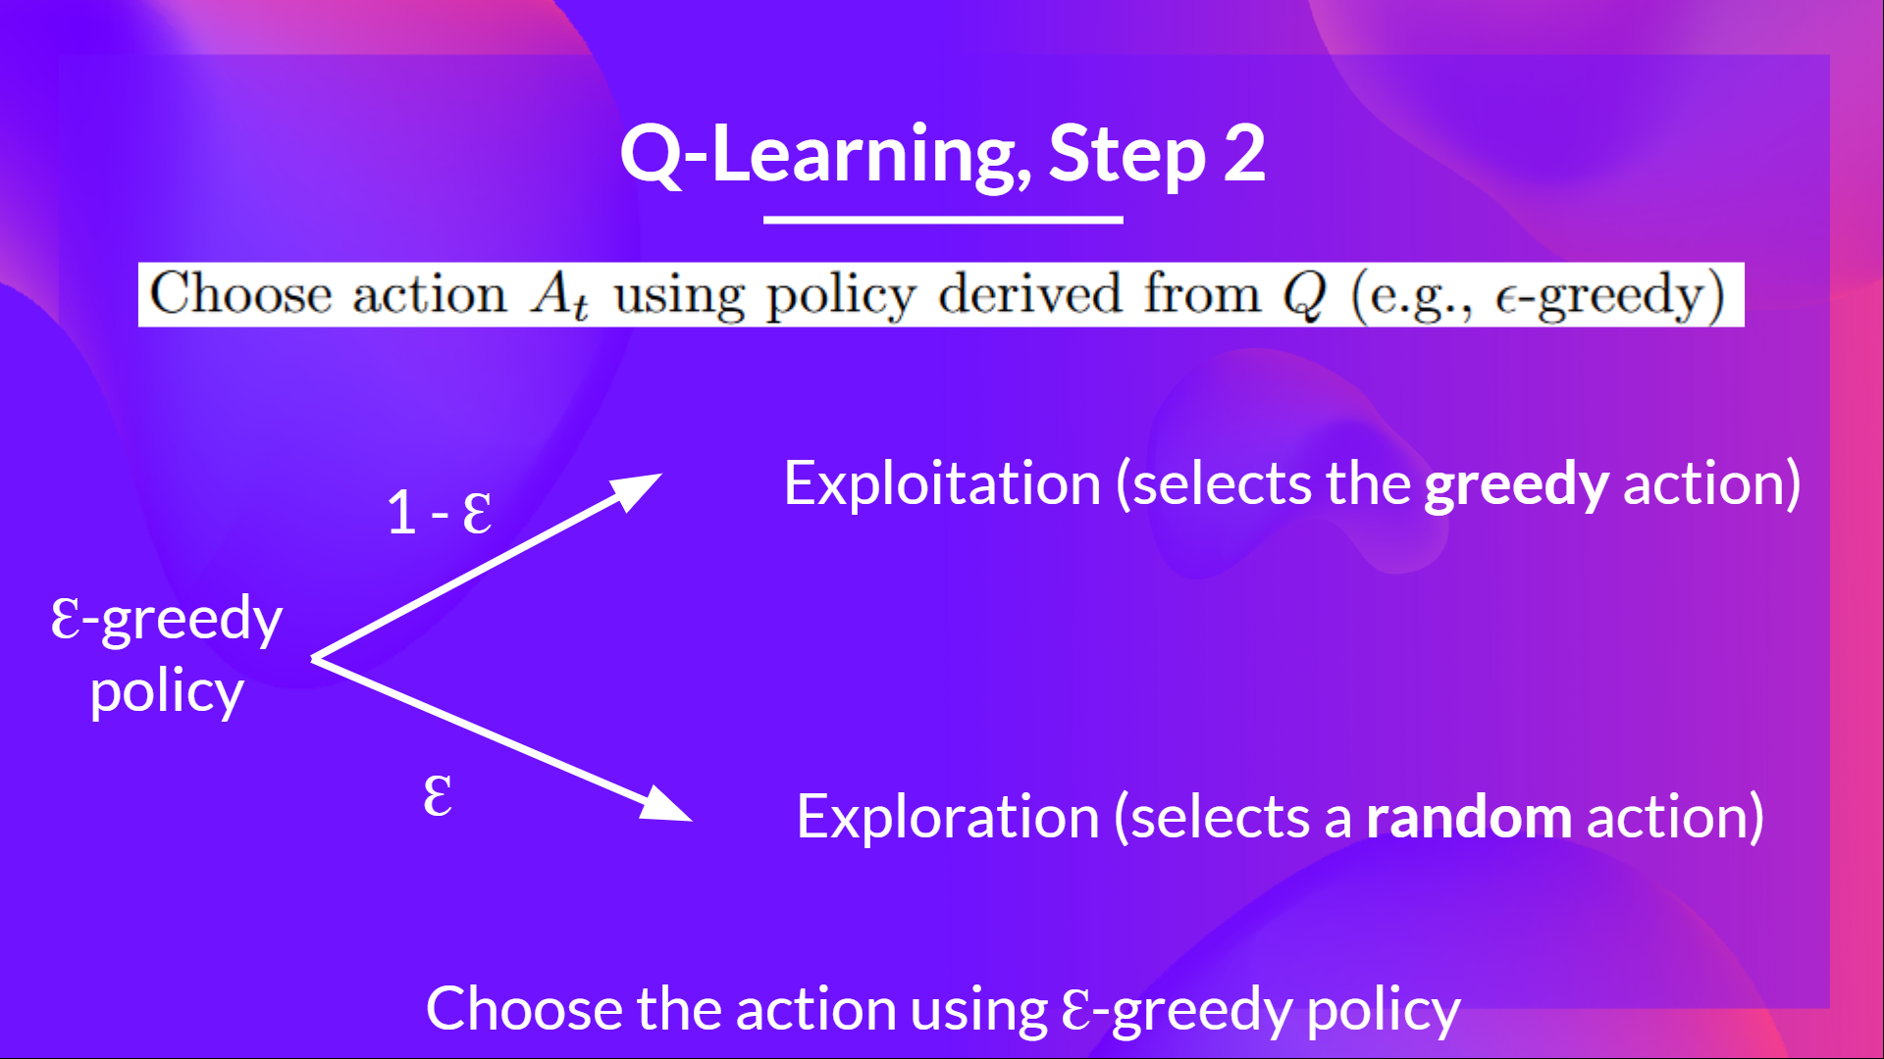
Q-Learning – We learn a Q-function, which is an action-value function that determines the value of being at a particular state and taking an action at that state. Q comes from “the Quality” (the value) of the action at that state

Slide 61
Q-Learning – We learn a Q-function, which is an action-value function that determines the value of being at a particular state and taking an action at that state. Q comes from “the Quality” (the value) of the action at that state
This is an Off-Policy method – it uses a different policy for acting (inference) and updating (training)

Slide 62
Q-Learning – We learn a Q-function, which is an action-value function that determines the value of being at a particular state and taking an action at that state. Q comes from “the Quality” (the value) of the action at that state
This is an Off-Policy method – it uses a different policy for acting (inference) and updating (training)
Updating uses Epsilon-Greedy Policy
With probability 1 - eps: we do exploitation (select action w/ highest state-action pair value)
With probability eps: we do exploration (random actions)
Acting uses a Greedy Policy

Slide 63
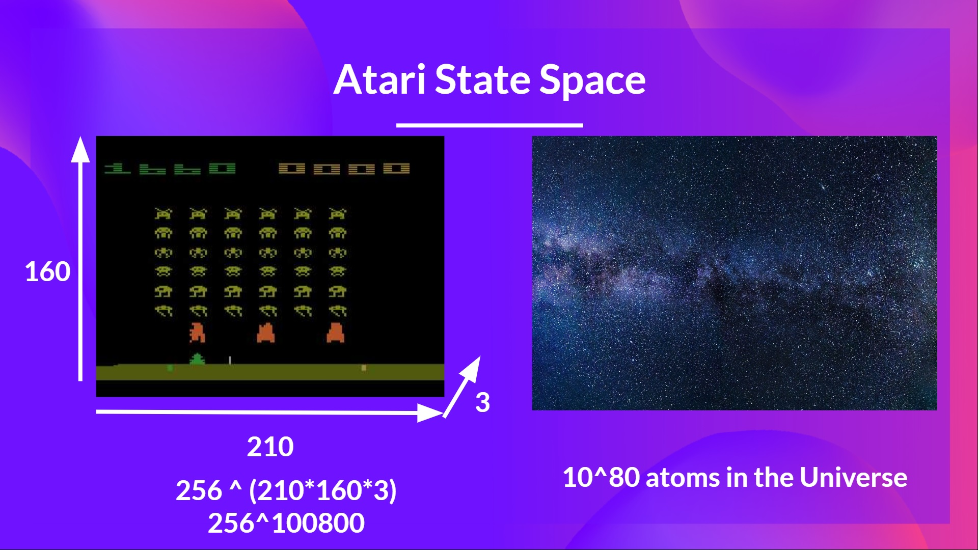

Slide 64
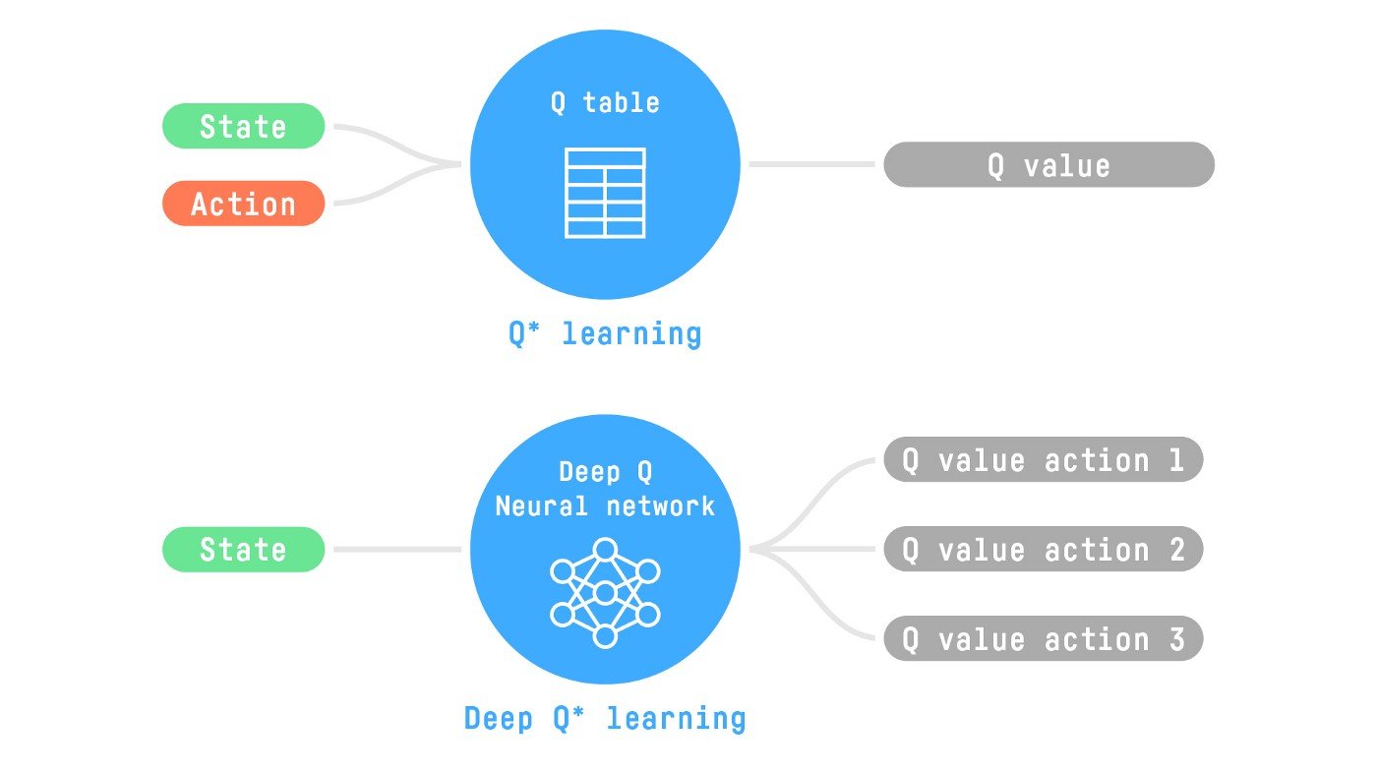
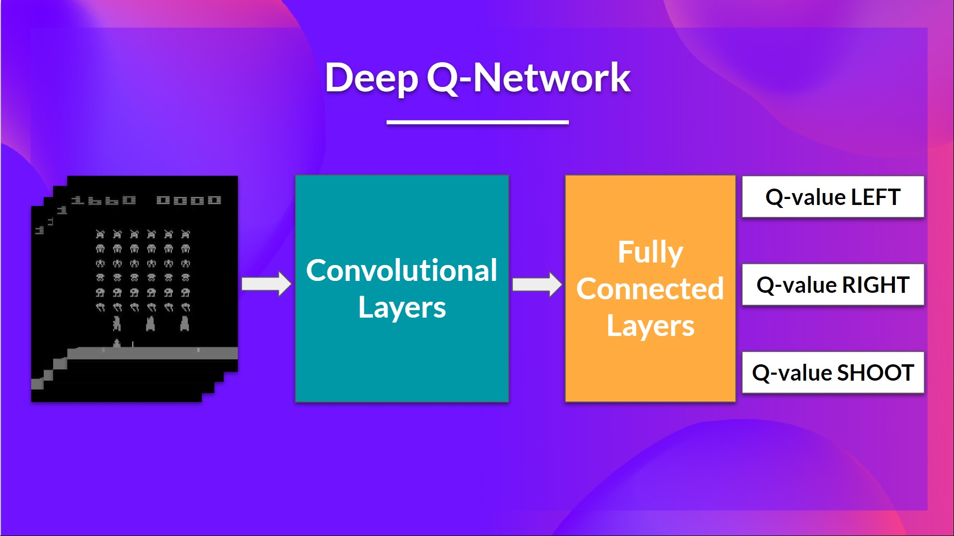
Deep Q-Learning
We will approximate the Q-values using a parameterized Q-function
The neural network will approximate, given a state, the different Q-values for each possible action at that state.
This approach is Deep Q-Learning
Input: Stack of 4 Frames
Output: Vector of Q-values for each possible action at that state
Like Q-learning, we use epsilon-greedy policy to select which action to take during training

Slide 65
Deep Q-Learning
At first, the Q-value estimation is terrible
However, during training, our DQN agent will associate a situation (from the frames) with the appropriate action and learn to play the game well

Slide 66
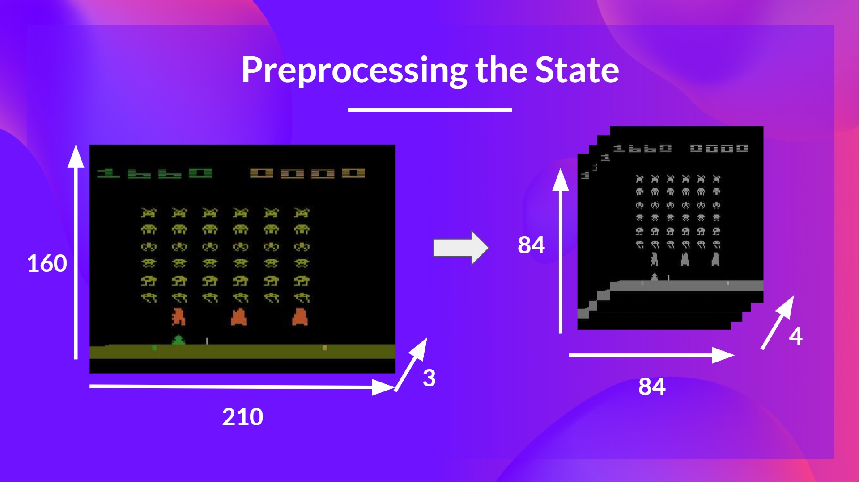
Deep Q-Learning
Preprocessing the input is essential since we want to reduce the complexity of our state to reduce computation time needed for training
Here, we reduce our state space to 84x84 and grayscale it.
Frame-stacking helps us handle the issue of temporal limitations

Slide 67
Deep Q-Learning

Slide 68
Double Q-Learning
With a high-level view of DQNs out of the way, we’re going to discuss an altered algorithm, Double-DQN (DDQN)
But for that, we need to go over some math…
Notes:
https://www.ri.cmu.edu/pub_files/pub1/thrun_sebastian_1993_1/thrun_sebastian_1993_1.pdf
^ If actions are uniformly distributed over [-ε, ε], each target is overestimated proportionately to ε

Slide 69
Double Q-Learning
Terminology: Q(s_{t} , a_{t}) := value of action a_{t} at state s_{t}
Taking action a_{t} at state s_{t} yields state s_{t+1} with reward r_{t+1}
i.e. our action is “good” if it
Yields a high reward
Yields a state with high quality (high Q value)
Therefore, we calc Q(s_{t} , a_{t}) as the reward of taking this step + the (discounted) Q value of the best possible action at the resultant state.
Finally, we have Q(s_{t} , a_{t}) = γ max_{a} Q(s_{t+1} , a) + r_{t+1}
Notes:
https://www.ri.cmu.edu/pub_files/pub1/thrun_sebastian_1993_1/thrun_sebastian_1993_1.pdf
^ If actions are uniformly distributed over [-ε, ε], each target is overestimated proportionately to ε

Slide 70
Double Q-Learning
Ideally, Q(s_{t} , a_{t}) = γ max_{a} Q(s_{t+1} , a) + r_{t+1}
=> Optimal when 0 = γ max_{a} Q(s_{t+1} , a) + r_{t+1} - Q(s_{t} , a_{t})
=> Temporal difference error, TD = γ max_{a} Q(s_{t+1} , a) + r_{t+1} - Q(s_{t} , a_{t})
Once TD → 0, we have finished optimizing
Introducing the Q-Learning update equation…
TD
Notes:
https://www.ri.cmu.edu/pub_files/pub1/thrun_sebastian_1993_1/thrun_sebastian_1993_1.pdf
^ If actions are uniformly distributed over [-ε, ε], each target is overestimated proportionately to ε

Slide 71
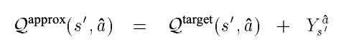
Double Q-Learning Issues
Issues with Q-Learning update equation
Works if precise values are stored for all state-action pairs
Thrun and Schwartz (1993): if we approximate Q with a function approximator (like our nnet…) over time Q-Learning overestimates target values
Our max_{a} Q(s_{t+1} , a) term converges to 𝔼( max_{a} Q(s_{t+1} , a) ) > max_{a} Q_{true}(s_{t+1} , a)
Notes:
https://www.ri.cmu.edu/pub_files/pub1/thrun_sebastian_1993_1/thrun_sebastian_1993_1.pdf
^ If actions are uniformly distributed over [-ε, ε], each target is overestimated proportionately to ε

Slide 72
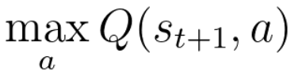
Double Q-Learning Issues
The big problem here is the max is doing too much heavy lifting:
There are two things happening here
Action evaluation (find Q value)
Action selection (pick a which yields max over Q)
What if we separate action selection from action selection?
Notes:
https://www.ri.cmu.edu/pub_files/pub1/thrun_sebastian_1993_1/thrun_sebastian_1993_1.pdf
^ If actions have errors uniformly distributed over [-ε, ε], each target is overestimated proportionately to ε

Slide 73
Double Q-Learning
Idea: separate action selection from action selection by creating a local approx and target approx
The algorithm is as follows:
Pick a* which maximizes Q^{L} in the next state
Calc Q^{T} over next state using a*
Plug into update equation (which uses Q^{L} for everything else)
Notes:
https://www.ri.cmu.edu/pub_files/pub1/thrun_sebastian_1993_1/thrun_sebastian_1993_1.pdf
^ If actions have errors uniformly distributed over [-ε, ε], each target is overestimated proportionately to ε

Slide 74
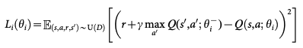
Deep Double Q Networks
Loss Function
Use neural nets as our Q function approximators (local net and target net)
Construct loss function to minimize our temporal difference error:
Experience Replay: we perform experience replay as normal, but we update our target network after C steps (a hyperparam) to contain the same params as local network
Notes:
https://www.ri.cmu.edu/pub_files/pub1/thrun_sebastian_1993_1/thrun_sebastian_1993_1.pdf
^ If actions have errors uniformly distributed over [-ε, ε], each target is overestimated proportionately to ε

Slide 75
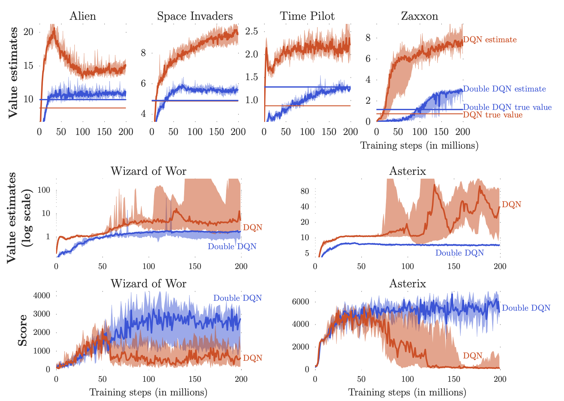
Deep Double Q Networks
Hasselt, Guez, and Silver, 2015
Notes:
https://arxiv.org/pdf/1509.06461.pdf

Slide 76
Mario Time!
https://acmurl.com/mario-ddqn

Slide 77
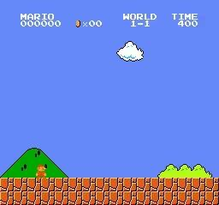
Wahoo!

Slide 78
(D)DQNs vs The World - Action Sampling
(D)DQNs are deterministic policies
Exploitation and exploration separated
Exploration is random action, i.e. sample from discrete continuous distribution
Exploitation Our local network spits out q values and we select the max; no variability, hence deterministic
Say you know how to drive a Prius. You just bought an F150 Truck. When you learn to drive the truck, do you do randomly try the AC, windows, e-brake, etc, or do you turn the ignition assuming the truck will turn on?
Hence Alternative: Stochastic Policies
Notes:
https://www.ri.cmu.edu/pub_files/pub1/thrun_sebastian_1993_1/thrun_sebastian_1993_1.pdf
^ If actions have errors uniformly distributed over [-ε, ε], each target is overestimated proportionately to ε

Slide 79
(D)DQNs vs The World - Action Sampling
(D)DQNs are deterministic policies
Stochastic policies encode action probabilities into a distribution (Categorical for discrete action space, Gaussian for continuous
When we want to act, we sample from the distribution
High probability == probably useful
Low probability == probably not useful
Low probability actions are still sampled, so our model can explore!
One less hyperparam B)
Notes:
https://www.ri.cmu.edu/pub_files/pub1/thrun_sebastian_1993_1/thrun_sebastian_1993_1.pdf
^ If actions have errors uniformly distributed over [-ε, ε], each target is overestimated proportionately to ε

Slide 80
(D)DQNs vs The World - On or Off Policy?
2. (D)DQNs are Off-Policy
(D)DQNs optimize Bellman Equation, not the policy – empirically can lead to better policy, but not guaranteed to work
See more: Sutton and Barto Ch 11 (linked in speaker’s notes)
Bootstrap (random sampling w/ replacement) + value method + Q-approximation == failure cases
Alternate Solution 1: Better Off-Policy algos, DDPG, TD3, SAC (SAC is research standard for off-policy)
Alternate Solution 2: On-Policy, policy gradient, REINFORCE, TRPO, PPO (PPO is research standard for on-policy)
Notes:
https://drive.google.com/file/d/1xeUDVGWGUUv1-ccUMAZHJLej2C7aAFWY/view

Slide 81
(D)DQNs vs The World - On or Off Policy?
2. (D)DQNs are Off-Policy
(D)DQNs optimize Bellman Equation, not the policy – empirically can lead to better policy, but…
When we want to act, we sample from the distribution
High probability == probably useful
Low probability == probably not useful
Low probability actions are still sampled, so our model can explore!
See more: Sutton and Barto Ch 11 (linked in speaker’s notes)
Notes:
https://drive.google.com/file/d/1xeUDVGWGUUv1-ccUMAZHJLej2C7aAFWY/view

Slide 82
Current Problems
in Deep RL
Presented by Stone Tao

Slide 83
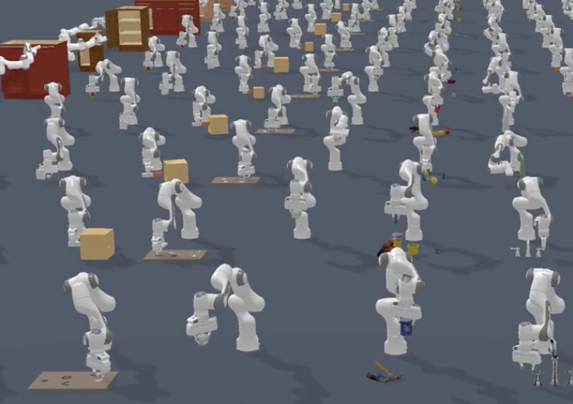
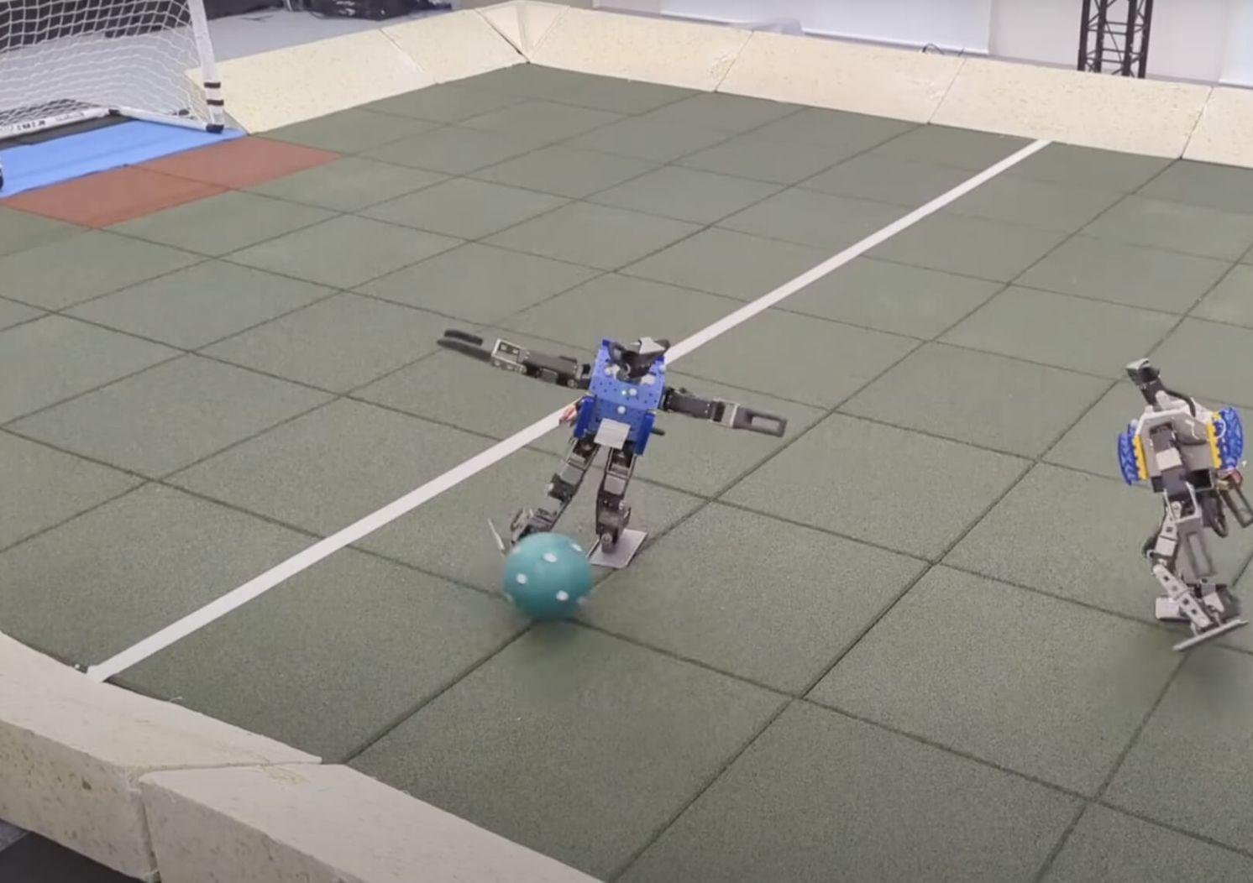
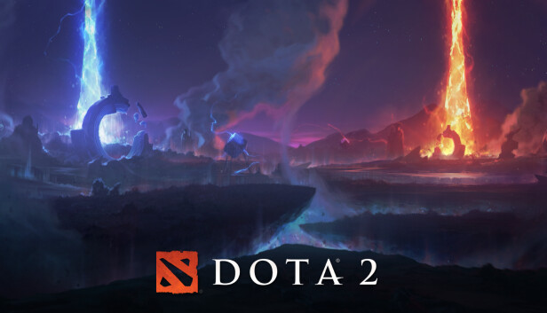
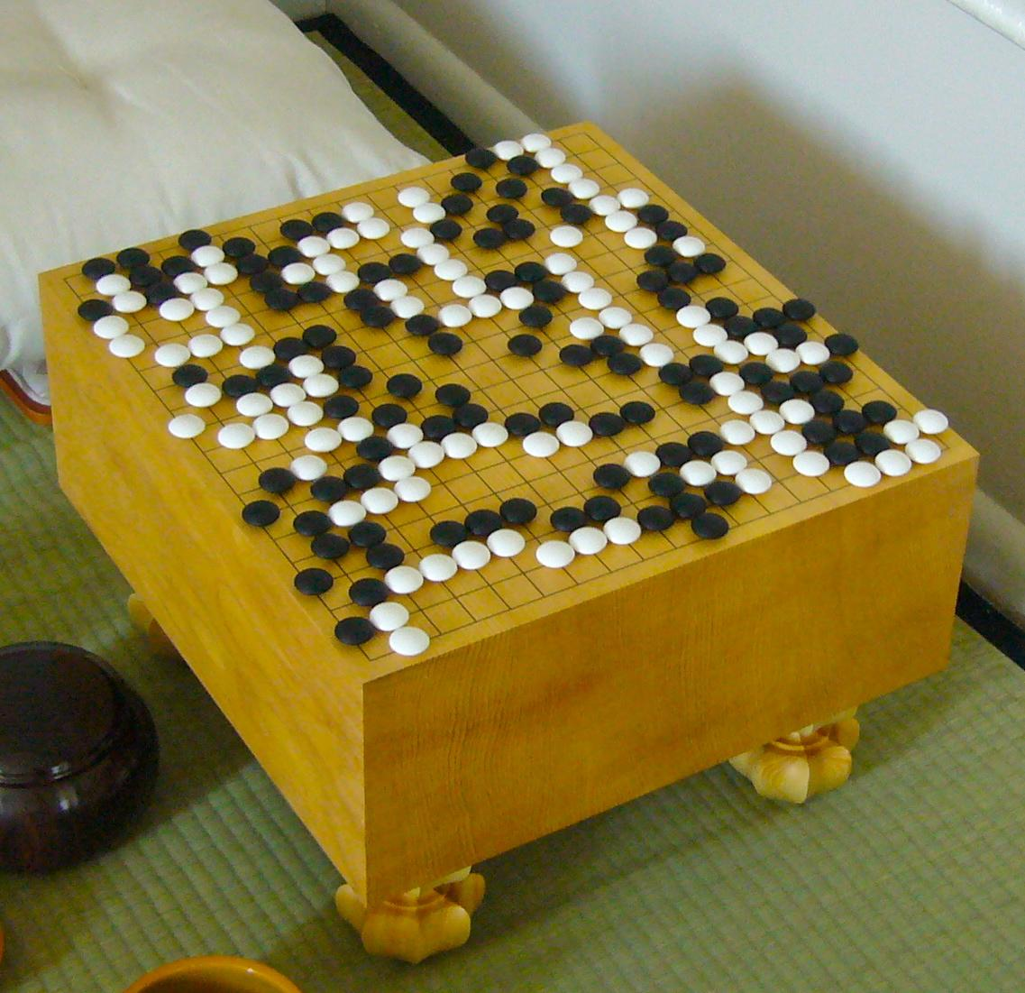
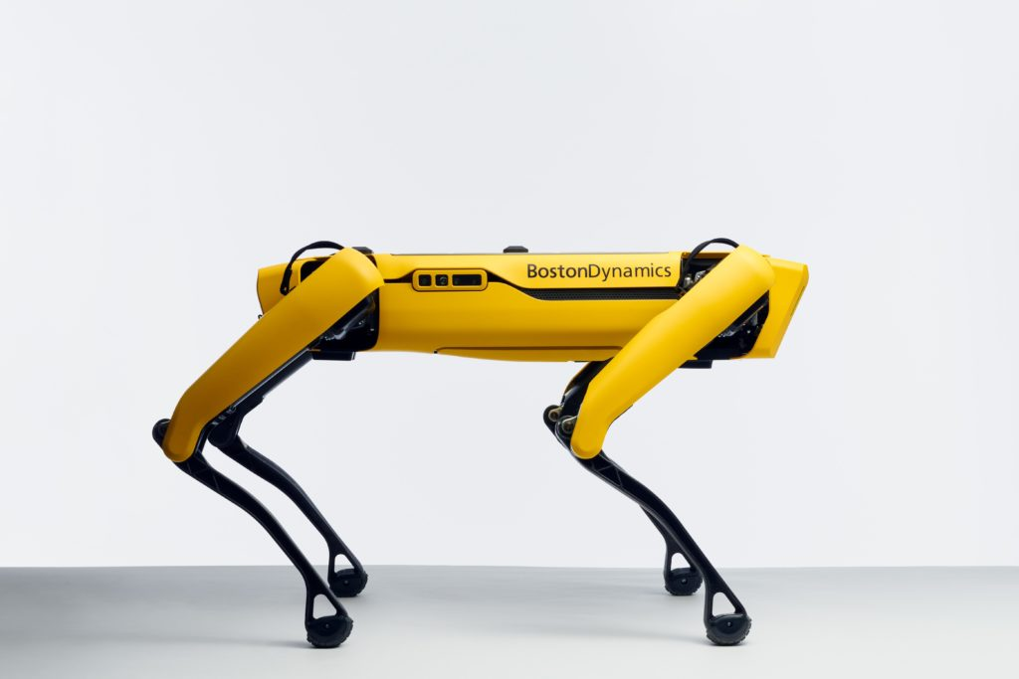
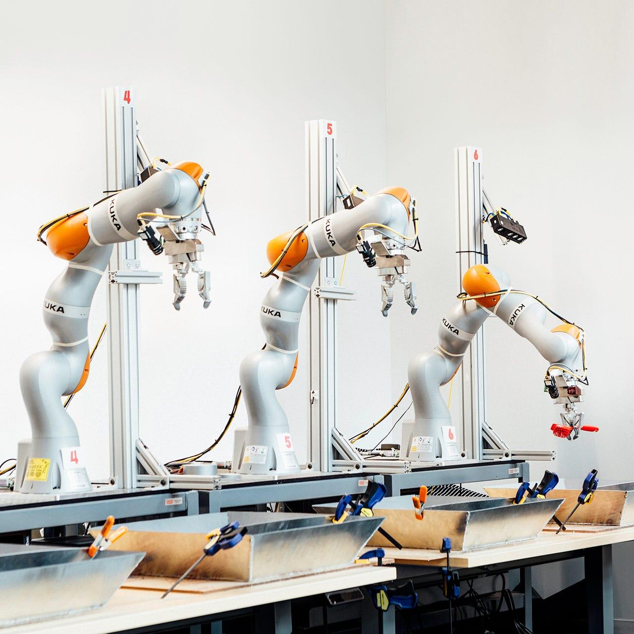
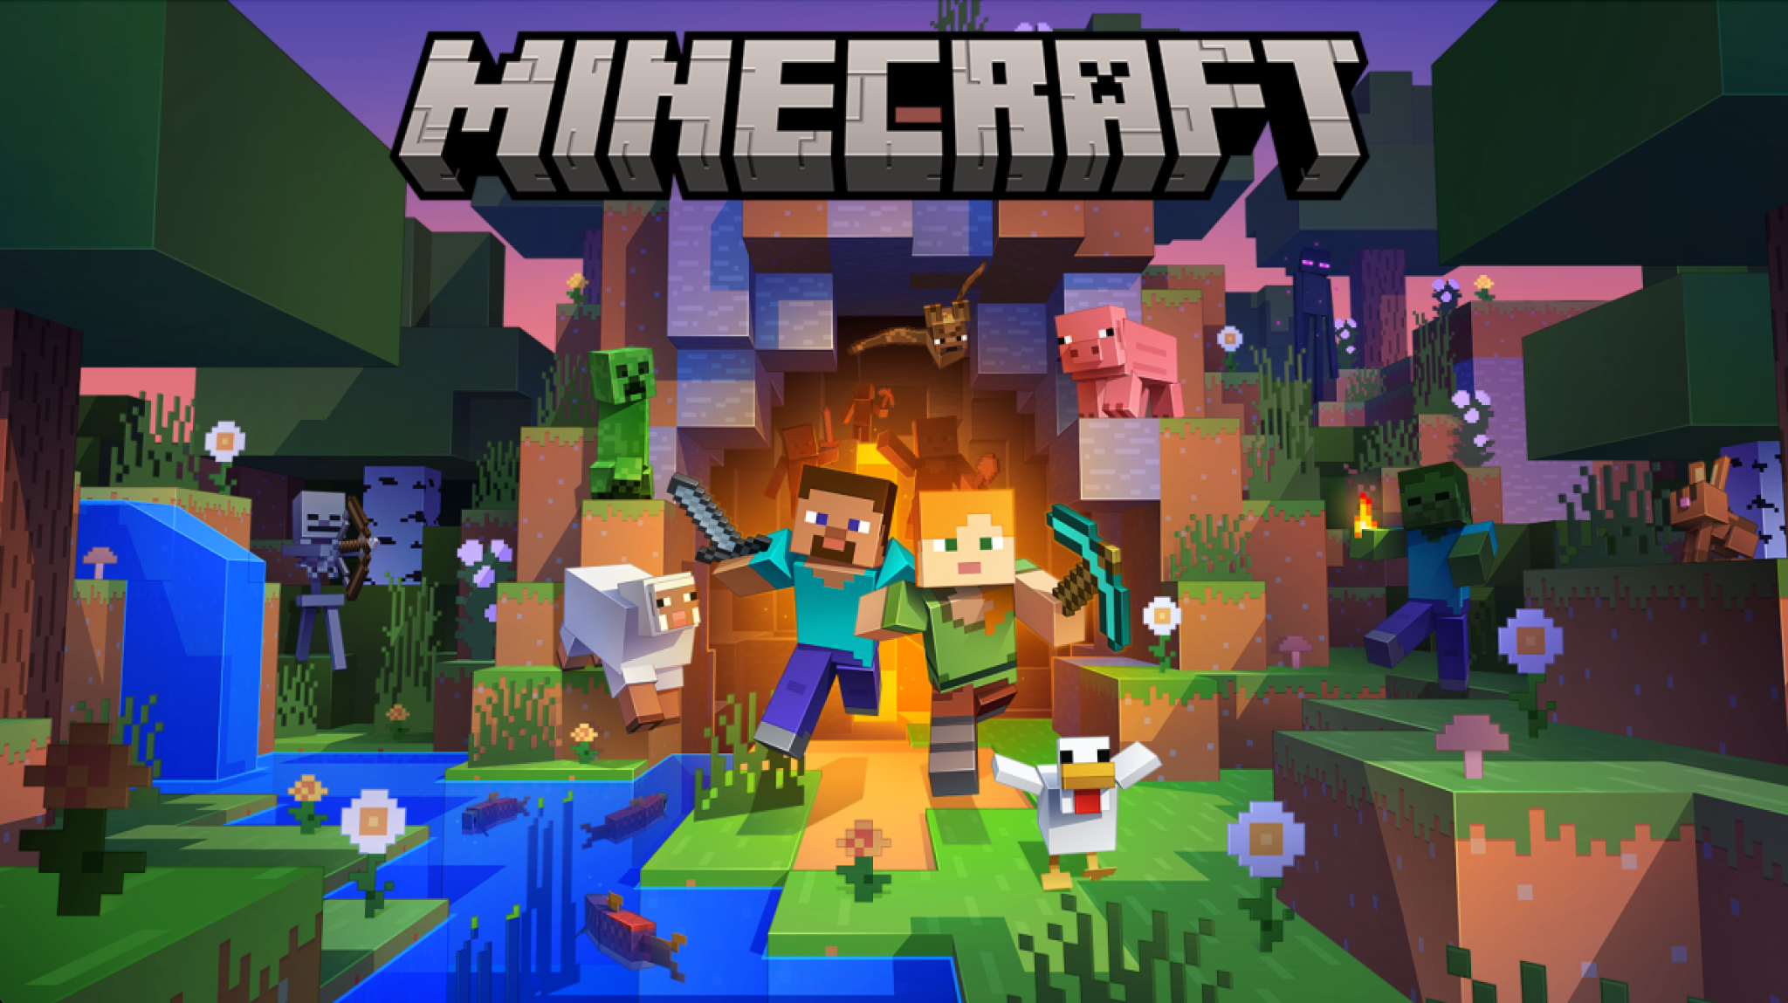
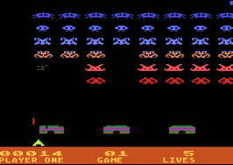
Downstream Applications
The well known ones
Robotics
Games

Slide 84





Downstream Applications
The not so well known ones
Policy making
Chip Design
Nuclear fusion control
Recommendation Systems
ChatGPT

Slide 85
Current Deep RL (stone)
Speed and efficiency: make training faster
Solving the impossible: do what we can’t easily program solutions for
IMO these are the general 2 goals of RL research, with many points of overlap. The research that goes into make algorithms smarter and faster lie in both theory/algos and engineering.

Slide 86
Current Deep RL (stone)
Theory/Algorithms: Learning from rewards, learning from demos, leveraging world-models…
Engineering: Training speed, environment speed, scaling data collection and processing, software engineering, clever prompting…

Slide 87
Sample Efficiency
Goal: Make training go brrrr (fast)
However, reinforcement learning is well known to be extremely slow, how come? Humans when born can learn quite a few things in a few years but give a few years of experience to an AI it can’t do a whole lot.

Slide 88

Sample Efficiency
Model-Free RL: Fast inference/training but uses many samples without using world models (for e.g. planning actions ahead)
Model-Based RL: Slower inference/training due to use of a model, but needs less samples to make better decisions thanks to use of a world model
Image from: https://spinningup.openai.com/en/latest/spinningup/rl_intro2.html

Slide 89
Sample Efficiency
On-Policy RL:
Can only train on experiences for the current iteration of the policy - less sample inefficient
The de-facto standard: Proximal Policy Optimization (PPO)
Off-Policy RL:
Can train on any experience, doesn’t have to come from the sampled policy - more sample efficient
The de-facto standard: Soft Actor Critic (SAC)
PPO (Schulman et al., 2017); SAC (Haarnoja et al., 2018)

Slide 90

World Models
Goal: Improving sample efficiency
Generally an idea that is more reflective of how humans sometime work.
When playing the game of Go, Chess etc. you must think several moves ahead to more optimally make choices.
Modern model-based RL (RL that uses world models) are all some flavor of this, and typically learn this world model.

Slide 91



World Models
There are some various examples and flavors of using world models
Planning in the original environment (MCTS)
Planning in observation space (images)
Planning in learned latent space
(encoding of images)
TD-MPC (Hansen et al., 2022); DreamerV3 (Hafner et al., 2022); Alpha Go (DeepMind, 2016)

Slide 92
World Models
Learning a complex world model is hard and slow! Planning with them scales with number of steps ahead planned.
While DreamerV3 can solve complex minecraft tasks and TD-MPC can solve complex robotic control problems, both take a long time to train
Planning in the original environment (MCTS)
Planning in observation space (images)
Planning in learned latent space
(encoding of images)
TD-MPC (Hansen et al., 2022); DreamerV3 (Hafner et al., 2022); Alpha Go (DeepMind, 2016)

Slide 93



Learning from Demonstrations
Goal: Tackle incredibly hard tasks where designing a reward may be difficult
How to mine diamonds?
What rewards?
Goal 1: Diamonds
Start
How to build a house?
What rewards?
Goal 2: Build a house

Slide 94

Learning from Demonstrations
Goal: Tackle incredibly hard tasks where designing a reward may be difficult
Getting diamonds are a long horizon, multi-staged problem…
Easily take 100 million samples on even the best algorithms, even with lots of hacks to make it easier
100M samples is about a month of straight playing time at 30FPS.
Figure from DreamerV3 (Hafner et al., 2022);

Slide 95
Learning from Demonstrations
Goal: Tackle incredibly hard tasks where designing a reward may be difficult
RL will work well if you provide an optimal reward function, but this is seldomly possible in incredibly complex environments like minecraft, robotics environments etc. and especially very long horizon problems (e.g. a sequence of tasks to arrange a dinner table)
A suitable replacement is to use demonstrations, past examples of how another person/robot/agent did a particular task (not necessarily optimally).

Slide 96
Learning from Demonstrations
Some typical approaches to leverage demonstrations
Behavior Cloning: Supervise learning the actions chosen for each observation in demo. Input is observation o_t, target/label is action a_t taken in the demonstration.
Offline RL: Generally encomposes methods that use no online interaction and use all kinds of information in a demonstration dataset (e.g. even modelling the reward to determine the optimality of demos and learn better)
Offline+Online RL: Learning from demonstrations while also using online interactions to improve the policy performance
Inverse RL: Learning a reward model from demonstrations to then generate rewards for an off-the-shelf RL algorithm like PPO or SAC

Slide 97

Learning from Demonstrations: Offline RL
Image from: https://bair.berkeley.edu/blog/2020/12/07/offline/
Notes:
Large body of different kinds of work in offline RL. In general you take a giant dataset of past interactions, analyze and train on that data and hopefully the trained policy can not only do well on what the interactions were generated for, but also tackle potentially new scenarios

Slide 98
Training/Inference Speed
Goal: Make the already slow RL training process go faster
There are a number of components to reinforcement learning training which differ from typical supervised learning and most machine learning methods. Each component contributes to the overall training time, but which components are actually horribly slow and need improving?

Slide 99
Training/Inference Speed
Where does the time go?
Training
Learning from online experiences
Learning from offline experiences
Augmenting experiences
Learning world models
Producing actions
Forward pass of model
Planning
Sampling the Environment
Process action
Generating observations

Slide 100
Training/Inference Speed
The big time eaters:
Training
Learning from online experiences
Learning from offline experiences
Augmenting experiences
Learning world models
Producing actions
Forward pass of model
Planning
Sampling the Environment
Process action
Generating observations
😠

Slide 101
Training/Inference Speed
Environment speed/FPS is usually the biggest bottleneck, especially for on-policy algorithms which are the most data hungry.
Speed is impacted by:
environment dynamics
sequential nature of environments
observation generation, especially visual observations

Slide 102
Training/Inference Speed
Solutions:
CPU based parallelization: Easiest to code for and scale. Simply parallel run an environment n times and get “n” times the FPS.
GPU based parallelization: Harder to code for usually but scales better -> cheaper.
CPU
Env
Env
CPU
Env
Env
GPU
CPU
Env
Env

Slide 103


Training/Inference Speed
GPU Based Parallelization (The future?)
For CPUs number of environments scale with number of CPU threads and RAM. As a result, 1 consumer-level GPU is easily equivalent to >= 2000 CPUs! (for simpler environments)
What GPU parallelization is available?
Jax-based environments allow for python style writing of GPU/TPU accelerated code instead of figuring out the vectorization math yourself
NVIDIA Isaac-Sim provides GPU parallelizable simulations with a PyTorch based backend (returns data on torch tensors)

Slide 104





Training/Inference Speed
Some GPU parallelized environments out there now
Brax: Robotics simulation on Jax
Jumanji: Variety of games on Jax
Gymnax: Classical RL problems on Jax
Lux AI: Large-scale multi-agent games on Jax
IsaacGym / Orbit: Robotics simulation on IsaacSim
Brax
Lux AI
IsaacGym

Slide 105
Software Engineering
Goal: Make RL easy to use
A huge part of the deep learning revolution and the frequency of downstream applications being built stems from good software and libraries.
Research has massively been accelerated thanks to the prototyping encouraging behavior of tools like PyTorch and Jax
People can build all kinds of LLM powered applications easily thanks to so many tools like HuggingFace transformers, LangChain etc.
RL is no different but engineering for RL has been very difficult…

Slide 106
Software Engineering
RL Standardization Problem
RL work often is composed of a few libraries: An RL algorithm library, an environment library, and potentially libraries to scale the previous two parts to many machines.
Only 3 components really, but it’s a mess
Many researchers will use their own algorithms library (e.g. me), or one of the many popular ones out there (Tianshou, Stable Baselines, RL Games, jaxrl, Clean RL etc.).
The environment interface is never consistent across research, there is the most popular one known as Gym/Gymnasium, but there is a different API for Brax (jax powered robotics), DeepMind environments, and more…
The way environments are designed (different control frequencies, horizon sizes) meaning it’s near impossible to reliably compare results on one env vs another.

Slide 107
Software Engineering
What then?
I’m not really sure to be honest. This can be in part due to the relative lack of maturity of modern deep RL, as well as how much more complex RL is compared to supervised learning etc.
Currently the Farama Foundation (who manage Gymnasium) are trying to consolidate this but this will definitely be a multi-year effort.

Slide 108
What is RL still missing?
What would be a breakthrough?
It can easily be said that language modelling has had a breakthrough thanks to transformers and recently large language models
Why hasn’t RL kicked off?
Sample efficiency remains a huge problem, too data hungry and can’t solve everything
Maturity needed for engineering to ensure end-users / laypeople can use it too

